Slide 1

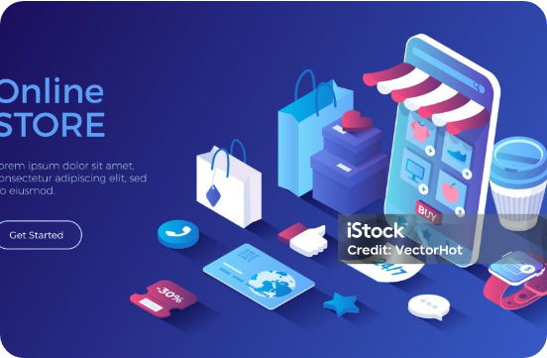

PROJECT INTRODUCTION
Express Grocery Web Platform
Kiran Shop Delivery
Next-generation web application for 15-minute doorstep grocery delivery and instant UPI checkout.
SPEED 15-20 Mins
CATALOG 32+ Essentials

Slide 2

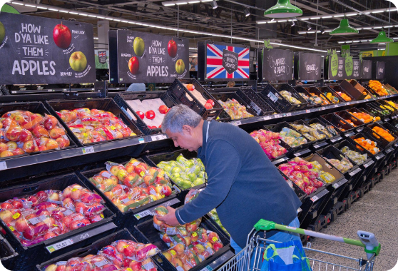
Market Inefficiencies
Problem Statement
Long Store Queues
30+ minute average waiting time at traditional billing counters.
Inventory Uncertainty
Frequent stockouts without real-time item availability tracking.
Delayed Delivery Cycles
Standard e-commerce platforms require 24–48 hours for dispatch.
Current Retail Pain Points

Slide 3
The Technical Architecture
Proposed Solution
Instant Checkout Flow
Multi-Modal UPI Pay
Zero-friction registration and single-page cart processing.
Seamless integration for Google Pay, PhonePe, Cards, & COD.
Real-Time Inventory Filtering
32+ Items
Categorized search for Fruits, Vegetables, Dairy, & Staples.
Kiran Shop Express Solution Architecture

Slide 4

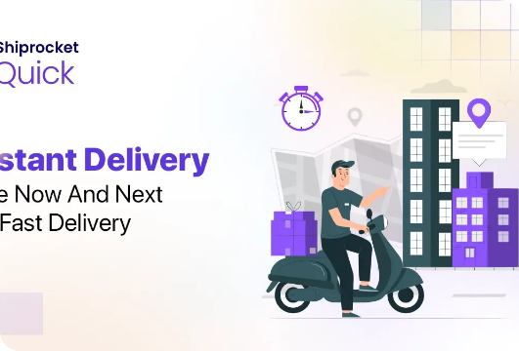
Project Key Metrics
Conclusion & Impact
15 Mins Average Delivery Window
100% Secure Encrypted Checkout
Key Project Takeaway
Kiran Shop Delivery successfully bridges the offline-to-online gap for urban neighborhoods with a lightweight, responsive web experience.
Final Summary & Value Proposition

Slide 5

KIRAN SHOP EXPRESS
Thank You!
Questions & Live Project Demonstration
www.kiranshop.express
|
support@kiranshop.express
Kiran Shop Delivery • Express Doorstep Service

Slide 6

Website link
Link :- https://kiranashopdelivery.netlify.app

